Slide 1
Operators

Slide 2
Operators are used to assign values, compare values, perform arithmetic operations, and more.
There are different types of JavaScript operators:
Arithmetic Operators
Assignment Operators
Comparison Operators
Logical Operators
Bitwise Operators
Conditional Operators
Type Operators

Slide 3
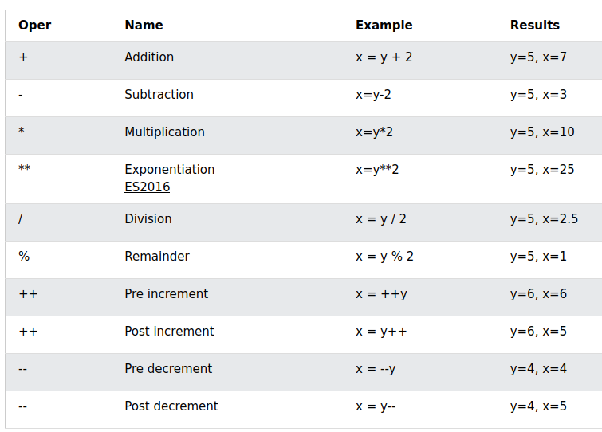
Arithmetic Operators

Slide 4
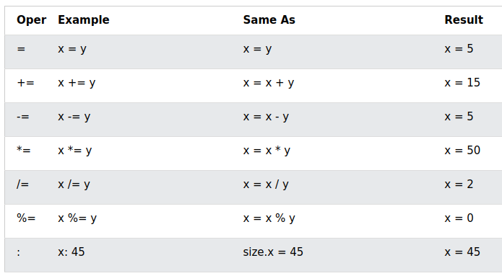
Assignment Operators
Given that x = 10 and y = 5, the table below explains the assignment operators:

Slide 5
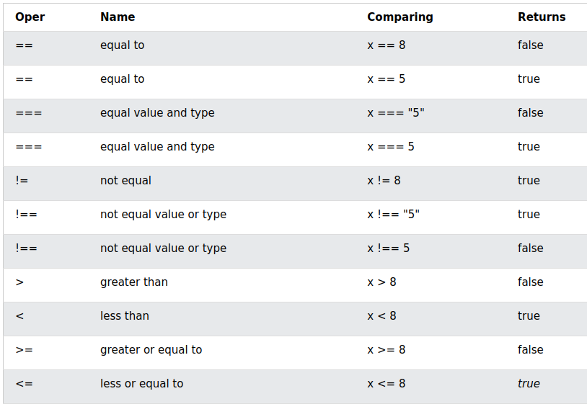
Comparison Operators
Given that x = 5, the table below explains the comparison operators:

Slide 6
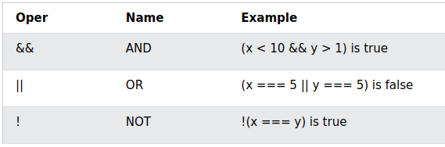
Logical Operators
Given that x = 6 and y = 3, the table below explains the logical operators:

Slide 7
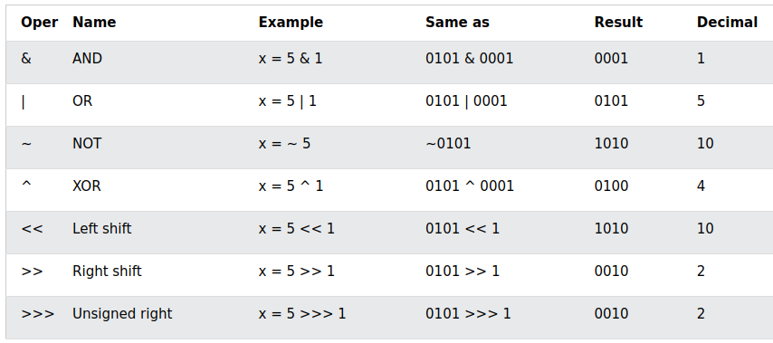
Bitwise Operators
Bit operators work on 32 bits numbers. Any numeric operand in the operation is converted into a 32 bit number. The result is converted back to a JavaScript number.
The table above uses 4 bits unsigned number. Since JavaScript uses 32-bit signed numbers, ~ 5 will not return 10. It will return -6.
~00000000000000000000000000000101 (~5)
will return
11111111111111111111111111111010 (-6)

